Slide 1

Chill ma Coding

Slide 2


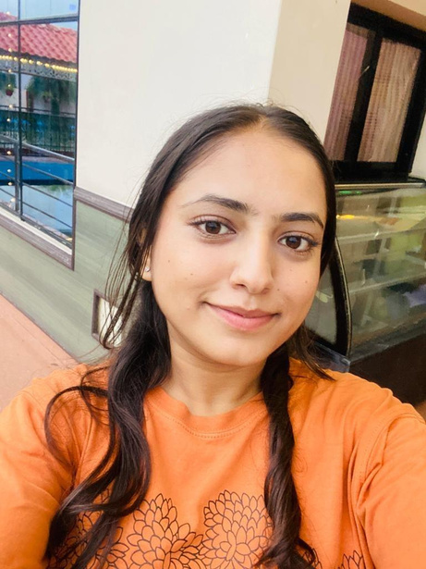
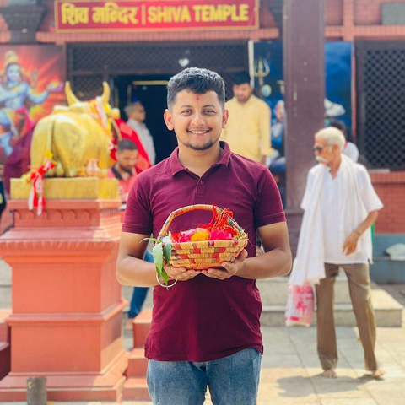

OUR TEAM
Alina Ghimire
Sanjok Gyawali
From Butwal

Slide 3
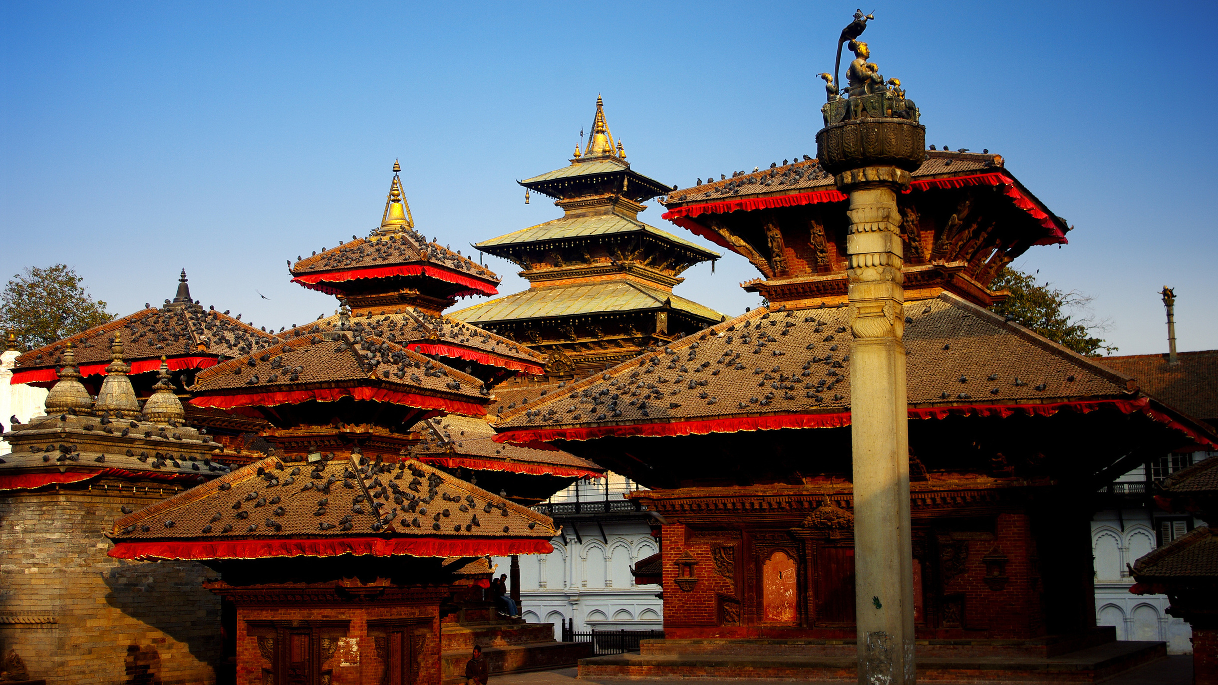
NEPOURISM(NEPAL+ TOURISM)
"Your Gateway to the Heart of Nepal"

Slide 4

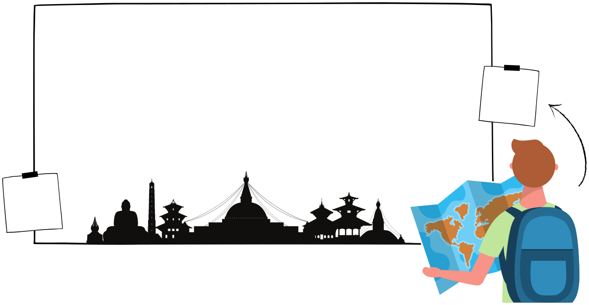
Why NEPOURISM?
k garcha ta Nepotismle?
kina chaiyo Nepotism?

Slide 5
Chill ma Coding
Let's understand the problem first.

Slide 6
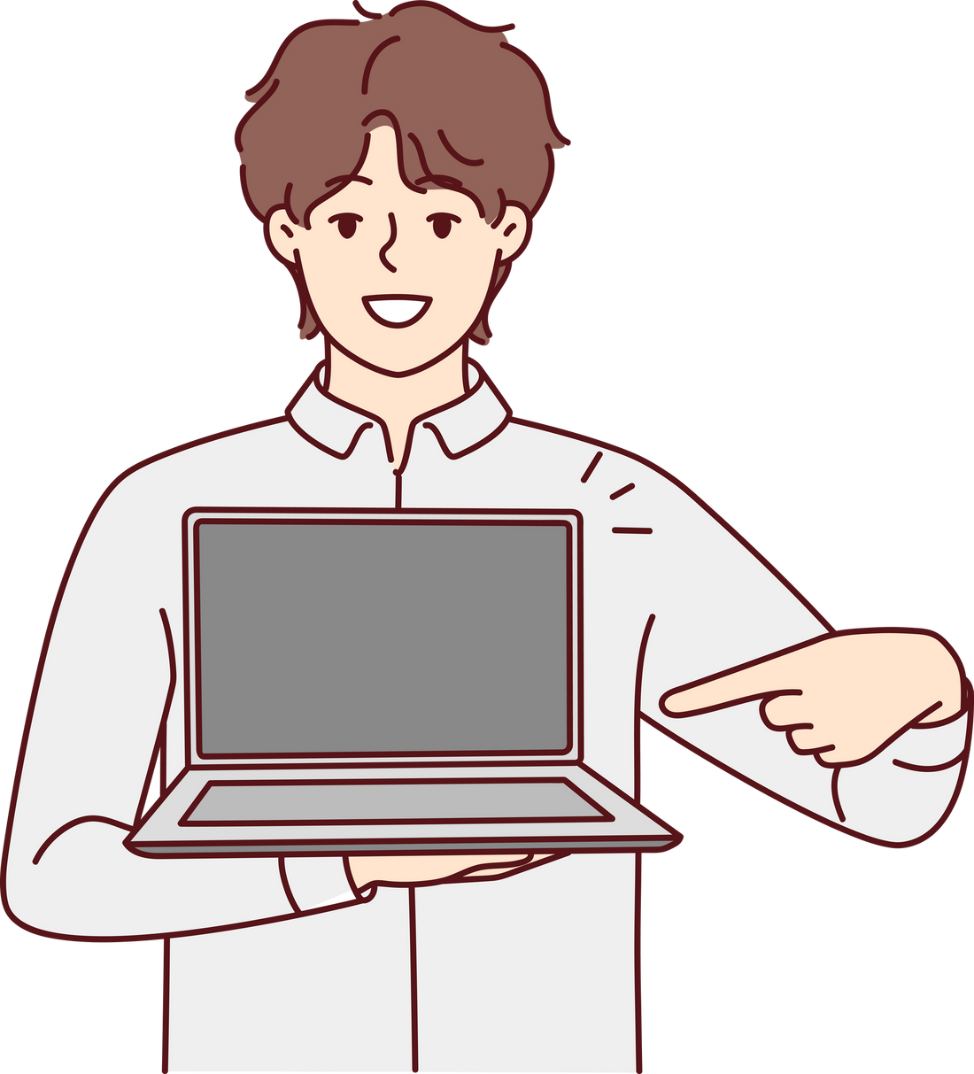


Here comes the solution NEPOURISM.

Slide 7
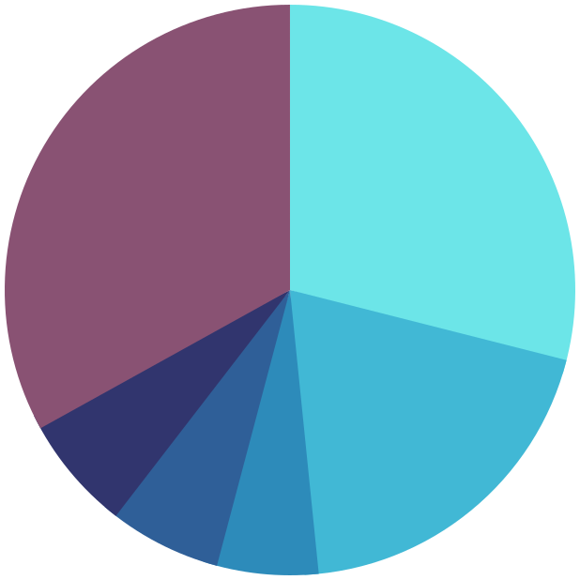
Nepal’s tourism traffic in a glance 2015-2023
Holiday Pleasure 29%
Others 33.1%
Official
6.5%
Pilgrimage
6.3%
Trekking and Mountaineering 19.4%
Business 5.7%

Slide 8



Chill ma Coding
Thank you!
NEPOURISM
"Your Gateway to the Heart of Nepal"

